Slide 1
Total Body Iron Removal in Thalassemia
John C. Wood, MD, PhD
Children’s Hospital Los Angeles

Slide 2
Cause of iron overload in thalassemia
Thalassemia Major
Transfusions deliver ~ 0.4-0.5 mg/kg/day of iron more than 20 times the normal absorption rate
One year of chronic transfusion therapy can increase the liver iron to between 15-20 mg/g
Thalassemia intermedia (or NTDT)
Increased iron absorption to more than 5 times normal
Iron accumulation is more insidious but is toxic if not treated

Slide 3
Iron Removal In Thalassemia
Phlebotomy is effective in patients cured of thalassemia by transplantation or gene therapy
Normal losses through the gut are minimal, approximately one transfusion’s worth of iron per year
While intravascular hemolysis can eliminate up to 8 transfusions worth of iron per year, most hemolysis in thalassemia is intramedulary
Thus iron chelation therapy remains the only viable therapy for iron removal in most thalassemia patients

Slide 4
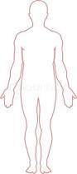
Where does excess iron go ?
Liver and spleen are the initial “depots” for transfused blood and long term reservoirs for excess iron
Endocrine glands including the pituitary, pancreas, thyroid, parathyroid gland and gonads are the most vulnerable to iron toxicity
Heart and vasculature iron deposition is a late but deadly complication of iron overload

Slide 5
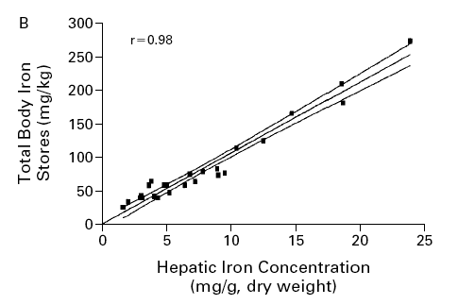
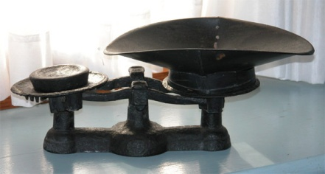
How Do We Assess Iron Balance ?
Grams
Prescribed
Compliance
Chelator
Efficiency
Iron From
Transfusions
Angelucci et al, NEJM, 343, 2000

Slide 6
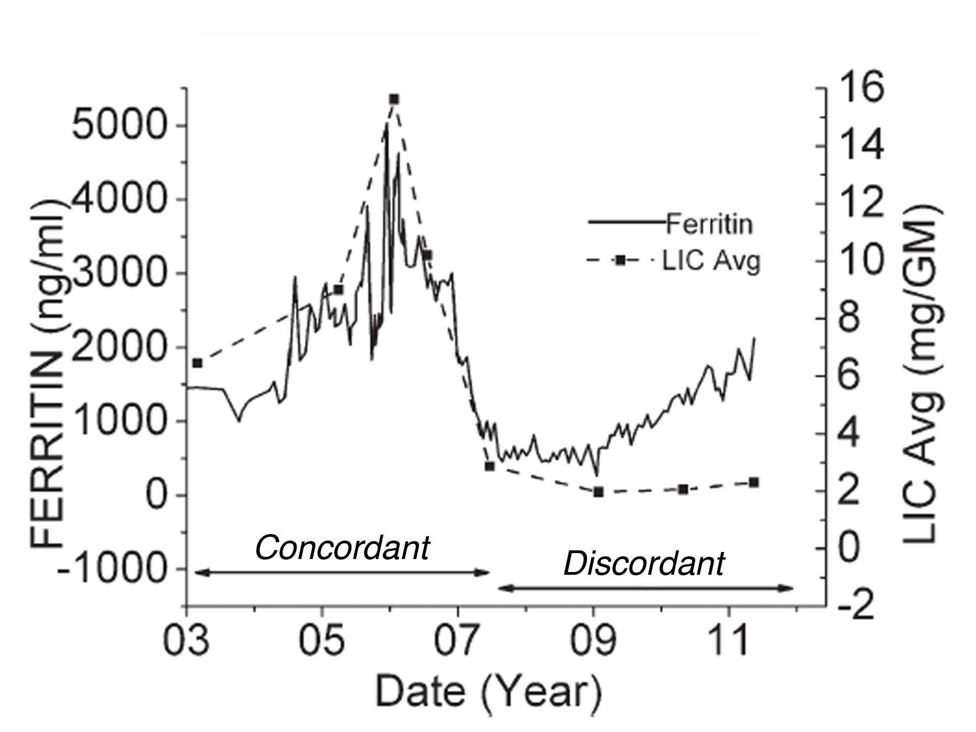
Serum Ferritin Tracks LIC…except when it doesn’t !
Using trends, overall r² was 0.64.
Trends in serum ferritin concordant with LIC in only 38% and overtly discordant in 28%.
Highly variable in nontransfused patients.
Puliyel et al, Am J Hematol 89(4):391-394,2014

Slide 7
R2 versus R2*, that is the question
Ferriscan R2
Liver R2*
Advantages
Good Quality Control
Well Validated
Disadvantages
Expensive
Longer Exam
Breathing Artifact
Less Robust to Tissue Iron Distribution
Advantages
Fast (single breathold)
Robust and Temporally Stable
Disadvantages
Requires Analysis Software
Requires Local Expertise
Smaller Dynamic Range

Slide 8
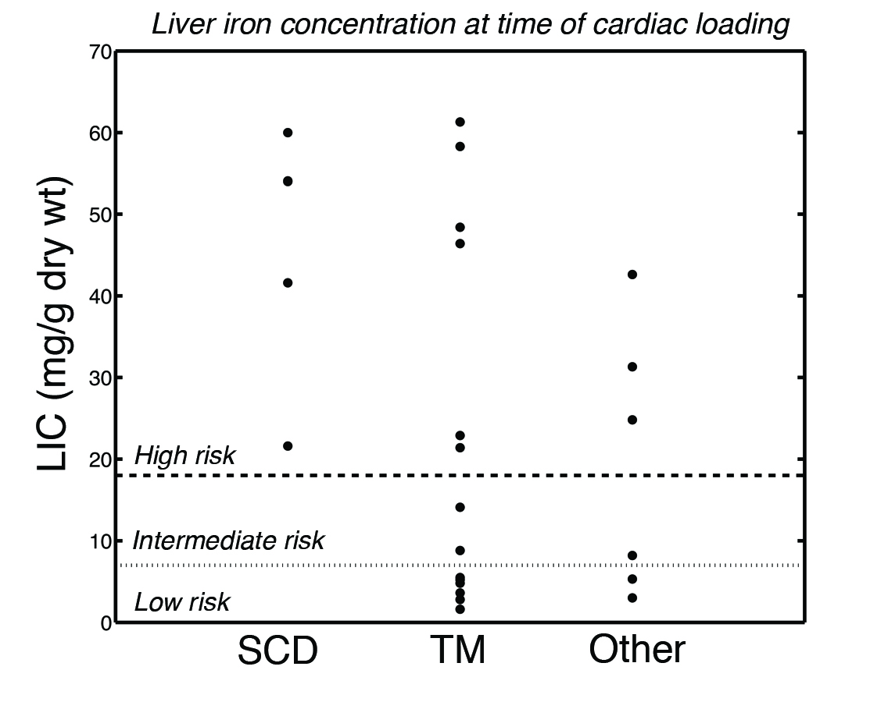
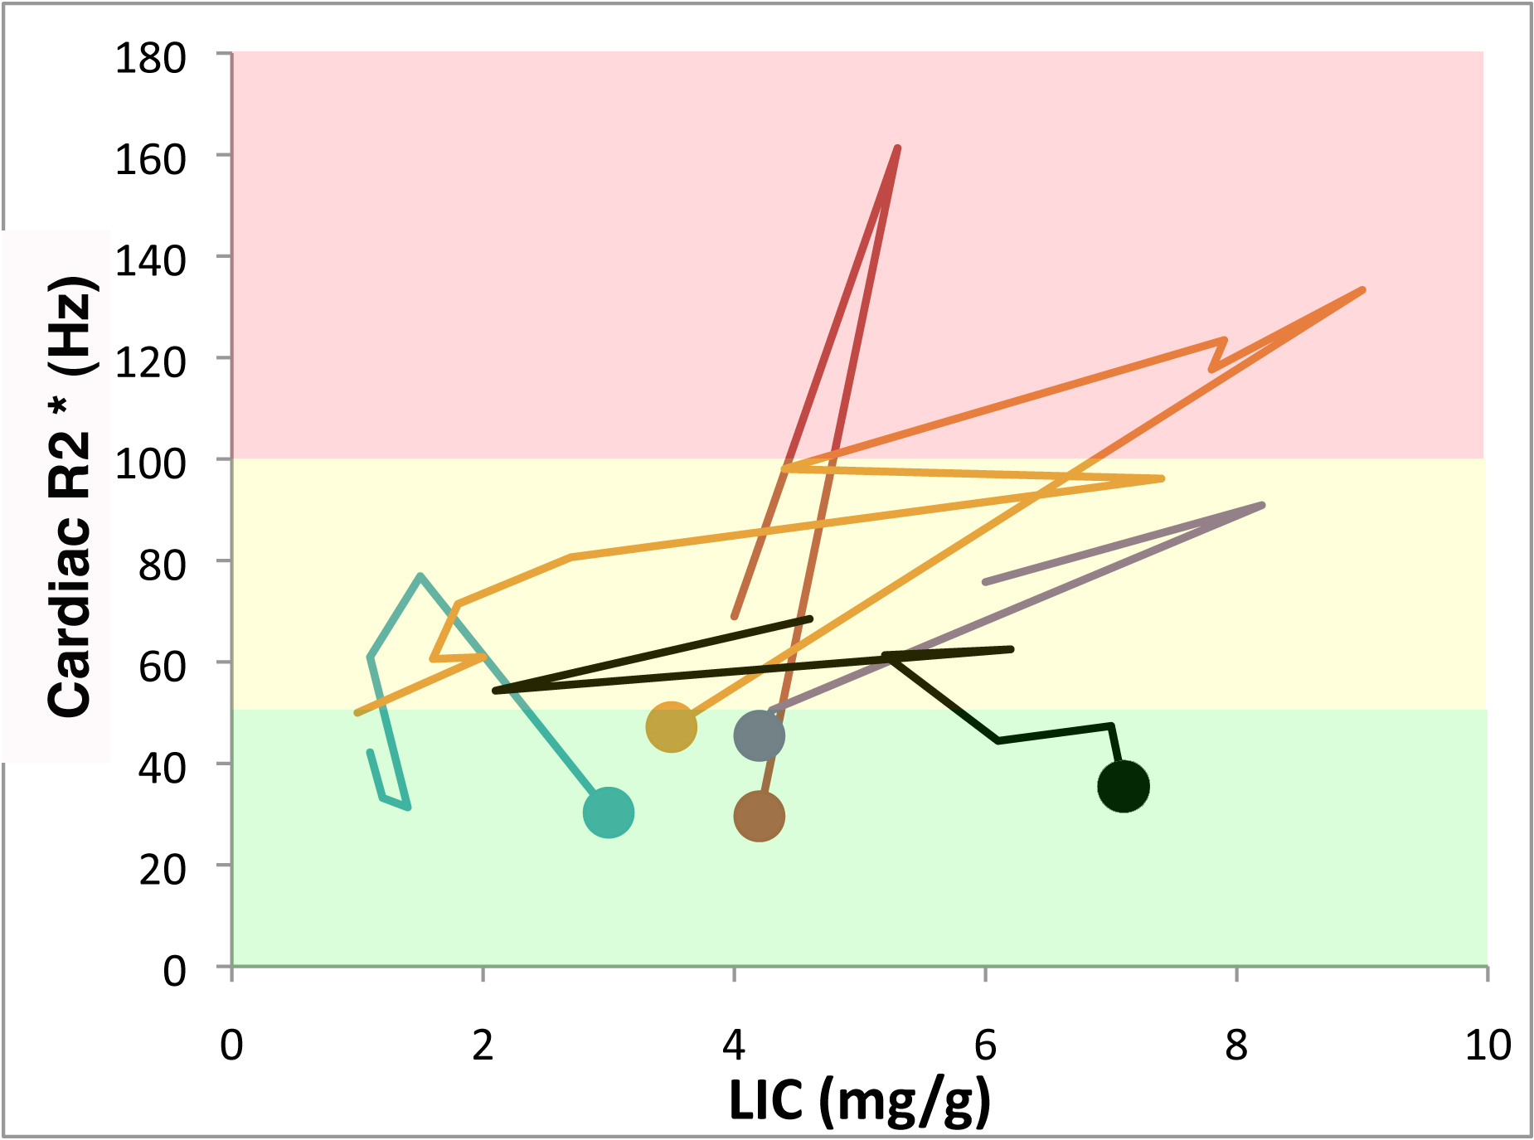
Heart can load despite low LIC
5/9 patients who prospectively developed cardiac iron had LIC < 7.
2/5 had rising LIC, 1 neutral and 2/5 falling.
No such thing as a “safe” LIC !
Severe
Severe
Moderate
Moderate
None
None

Slide 9
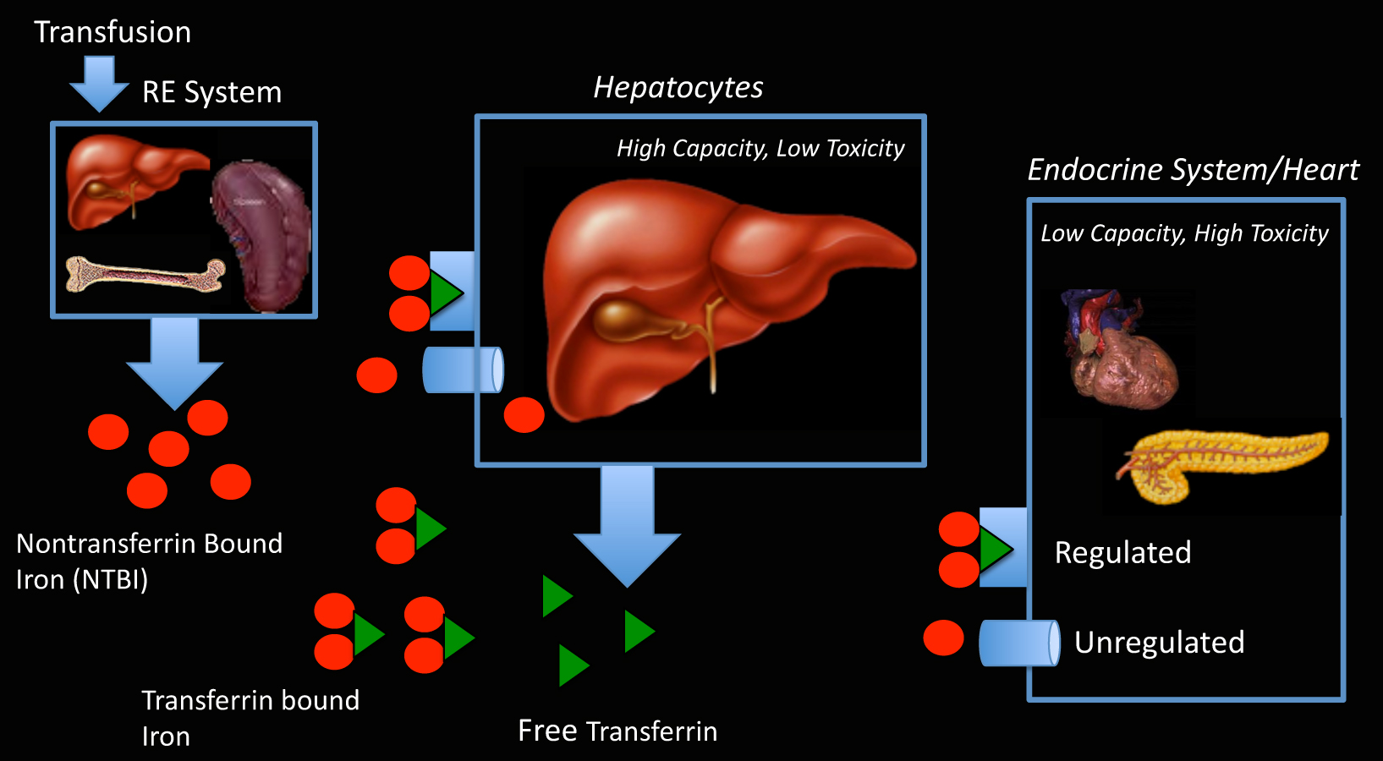
Heart and glands take up NTBI

Slide 10
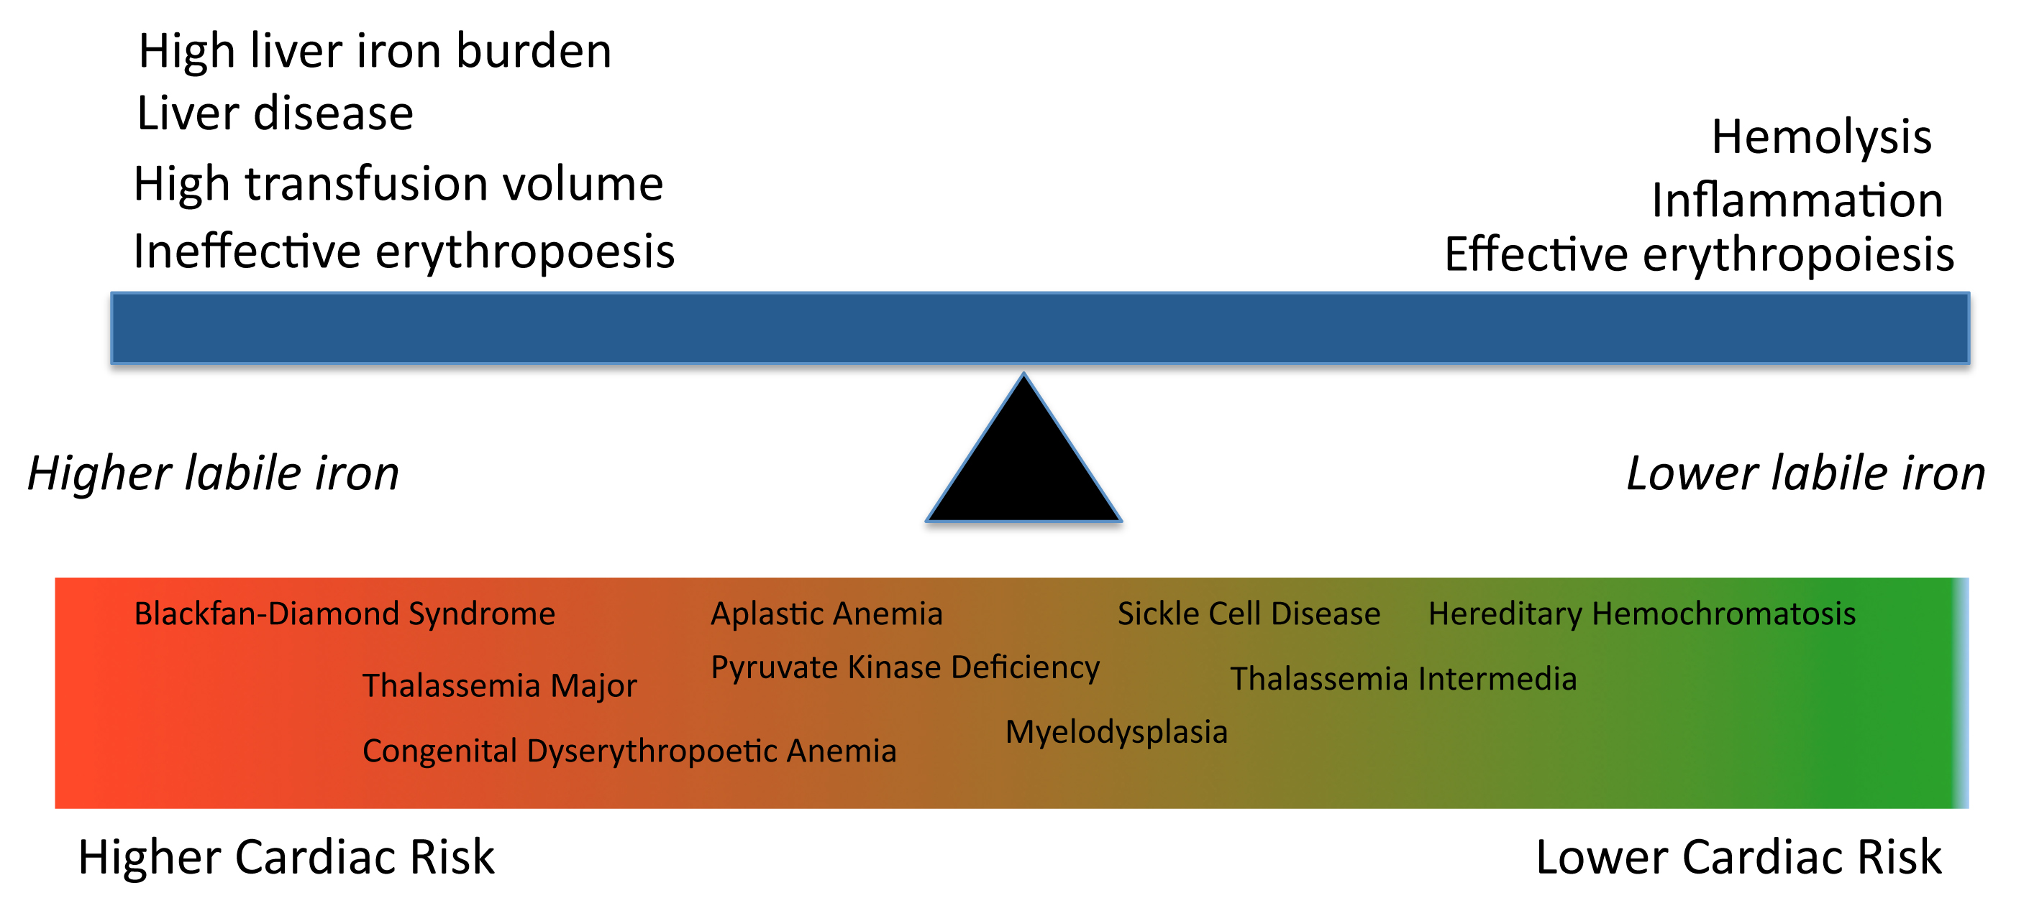
Cardiac iron risk
transfusions
Transferrin
erythropoiesis
Garbowski et al, Haematologica, 102(10):1640-9, 2017

Slide 11
Chelation
Sun
Mon
Tues
Wed
Thurs
Fri
Sat
Heart,
endocrine
Doses
Heart,
endocrine
LPI
transfusions
LIC≈
Doses
chelation
LPI
The liver cares about how many grams per week of iron chelators.
The heart (and endocrine glands) cares about how many days per week there is iron chelation.

Slide 12
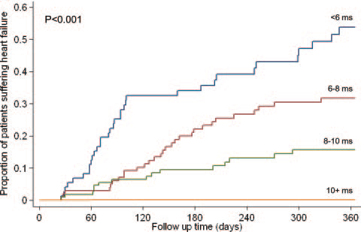
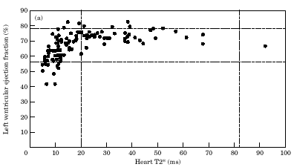
Cardiac T2* and cardiac dysfunction
Left ventricular ejection fraction (%)
Kirk et al, Circulation, 120(20)1961-8, 2009

Slide 13
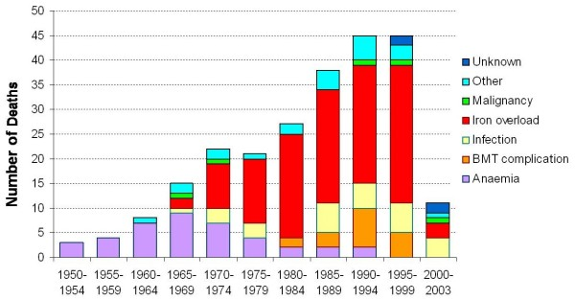
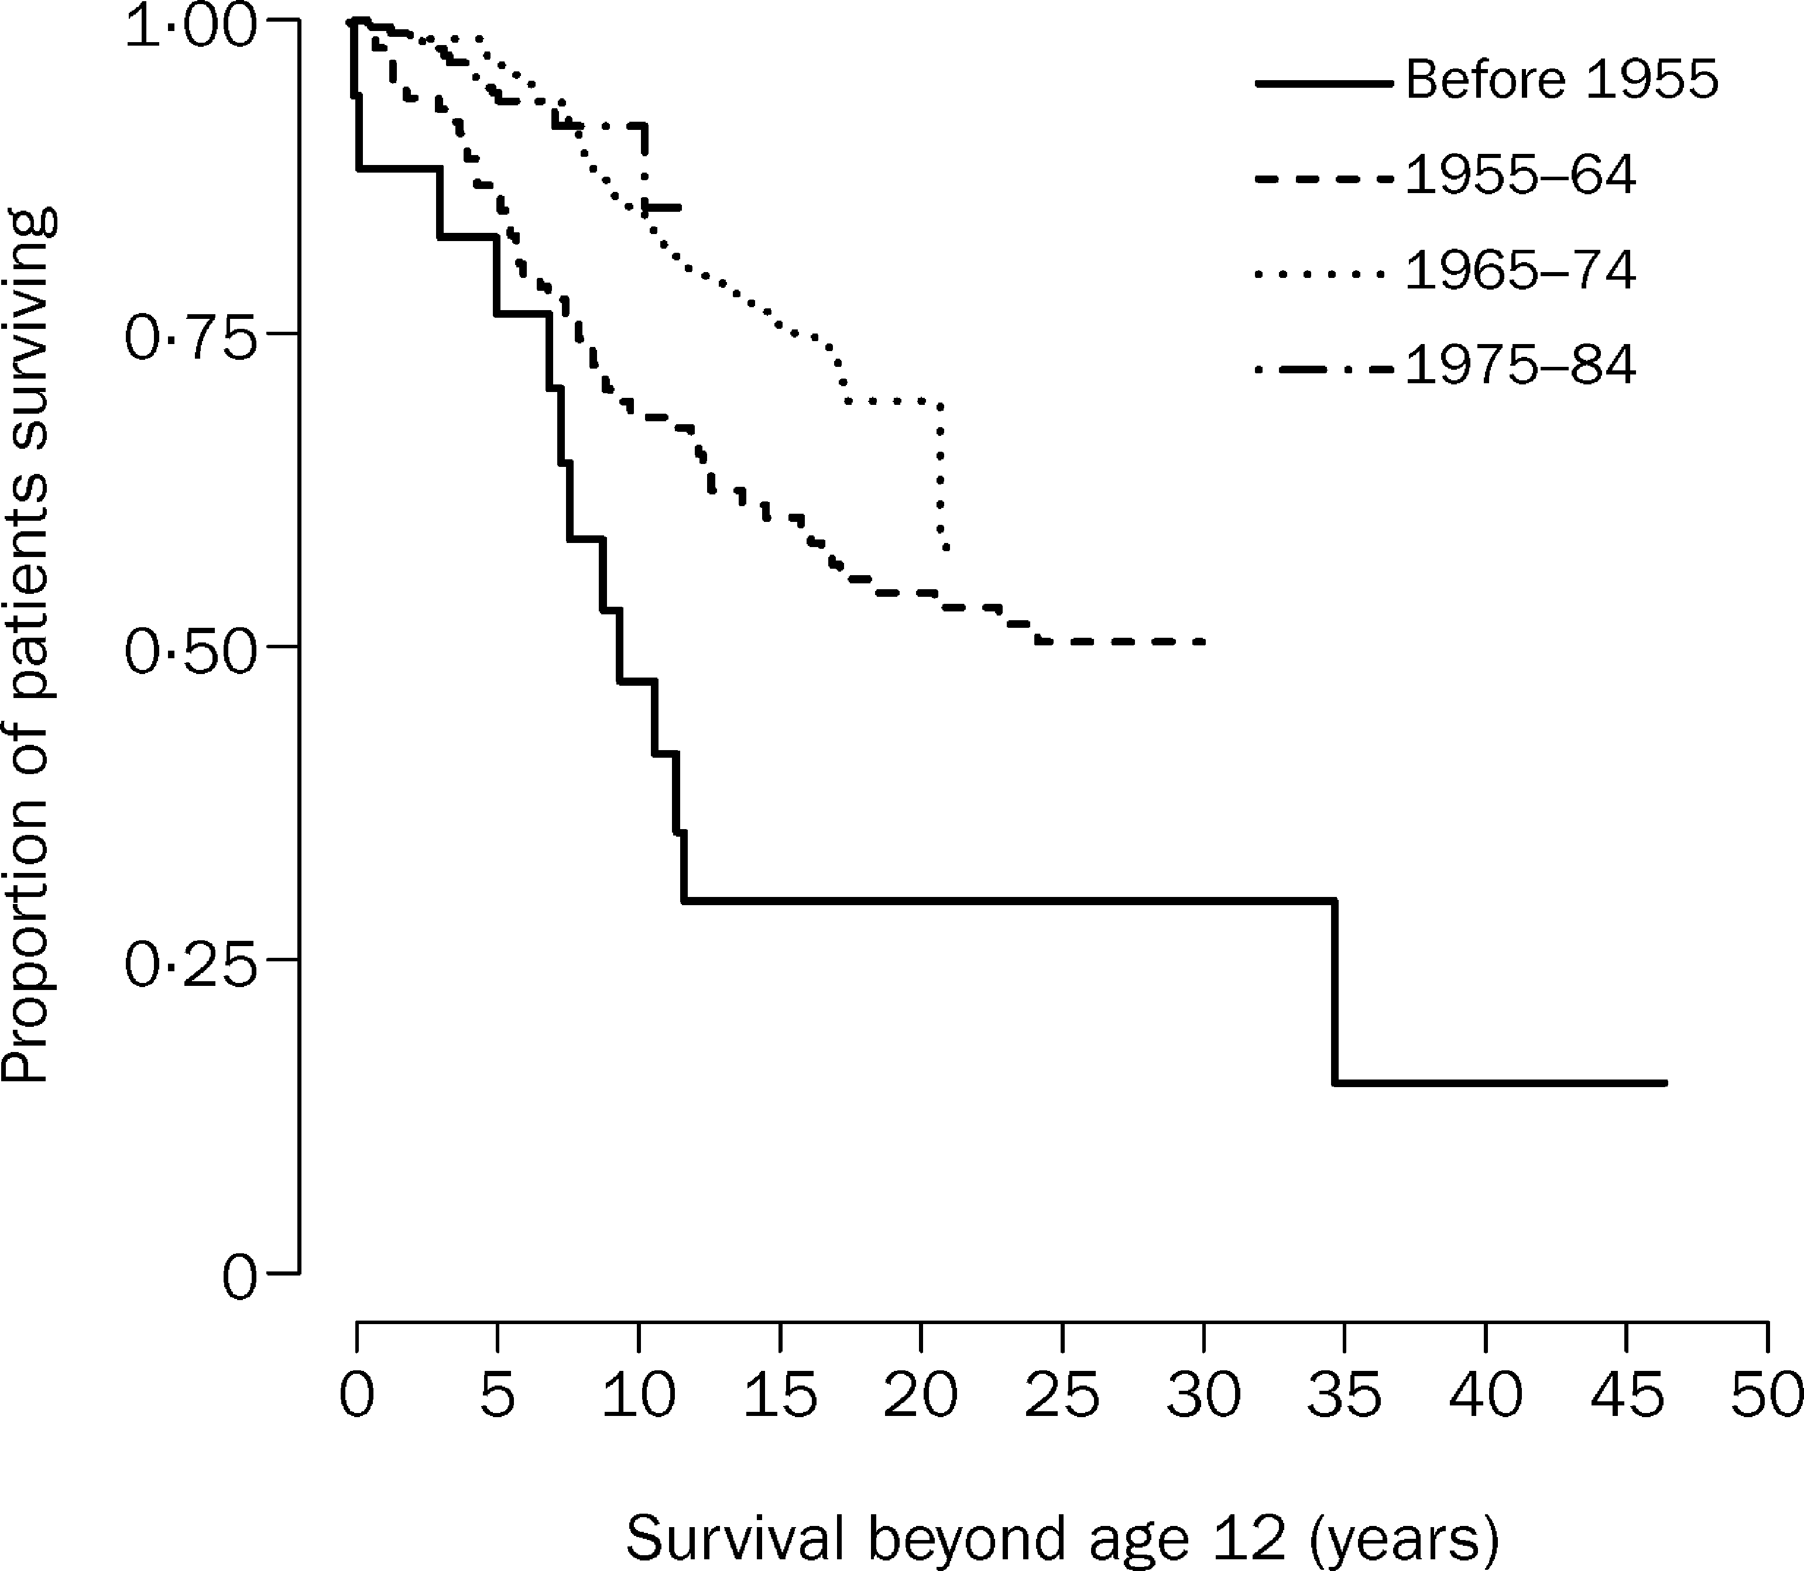
Trends in Mortality
Modell et al, JCMR, 10(1):42, 2008

Slide 14
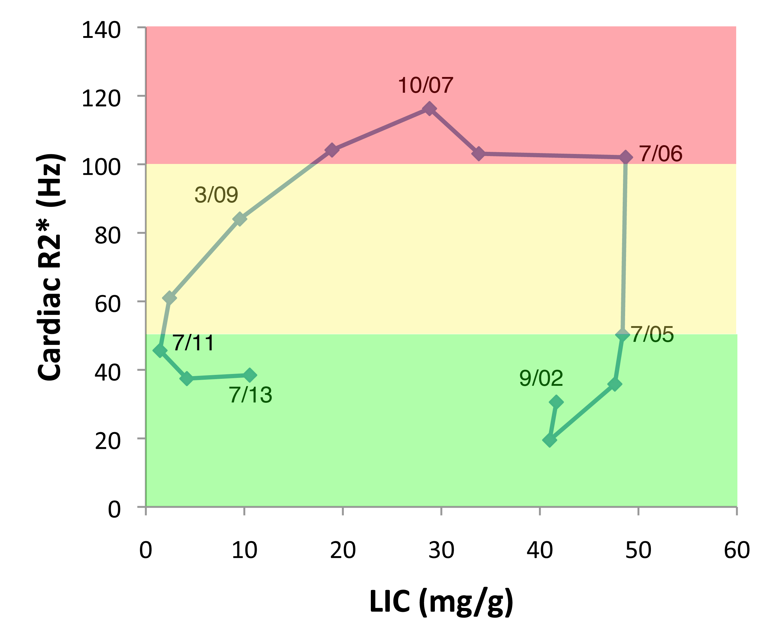

Fast Uptake/Slow Clearance
Liver Iron

Slide 15
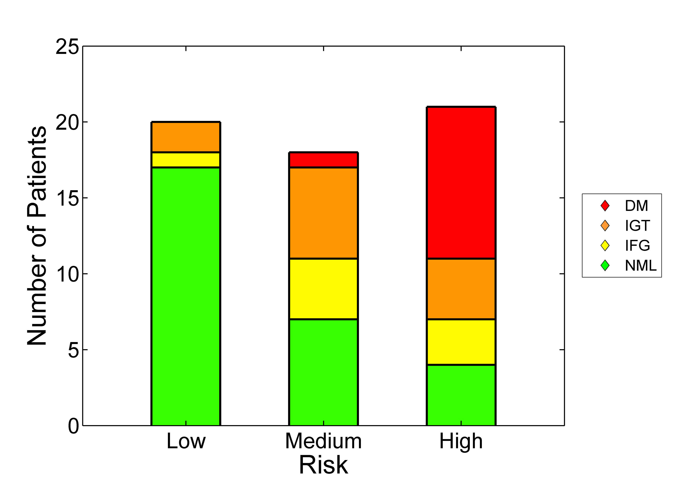
Glands say, “Don’t wait for T2* to fall”
Pancreas
- Heart
+ Pancreas
- Heart
+ Pancreas
+ Heart
The endocrine glands load earlier than the heart.
Endocrine iron loading causes toxcity.
Noetzi et al, Am J. Hematol. 87(2):156-160 & 167-171, 2012

Slide 16
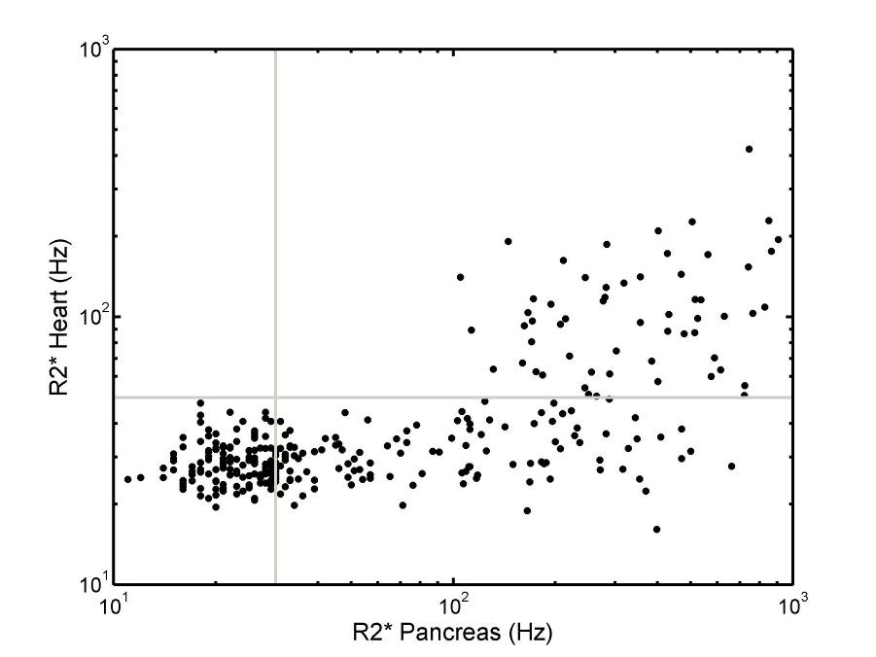
Pancreatic iron heralds heart iron !
- Pancreas
+ Heart
+ Pancreas
+ Heart
R2* = 100 Hz
CHLA
Pancreas loads early, “where there’s smoke there’s fire”
Pancreas R2* reflects LPI exposure, similar to HbA1C and glucose.
Noetzli et al, Blood 114(19); 4021-6,2009
Noetzli al, BJH,152(2):229-33, 2011

Slide 17
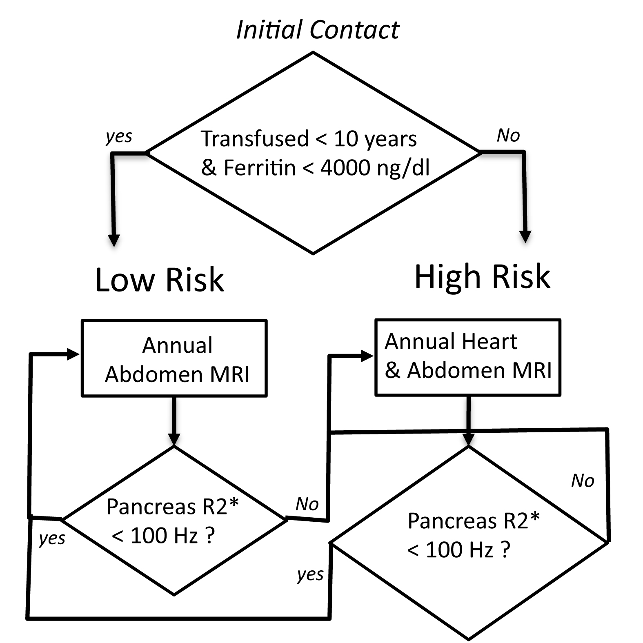
Staged MRI screening
Pancreas R2* < 100 Hz
Wood J, Blood Cell Mol Dis, 67:120-5,2017

Slide 18
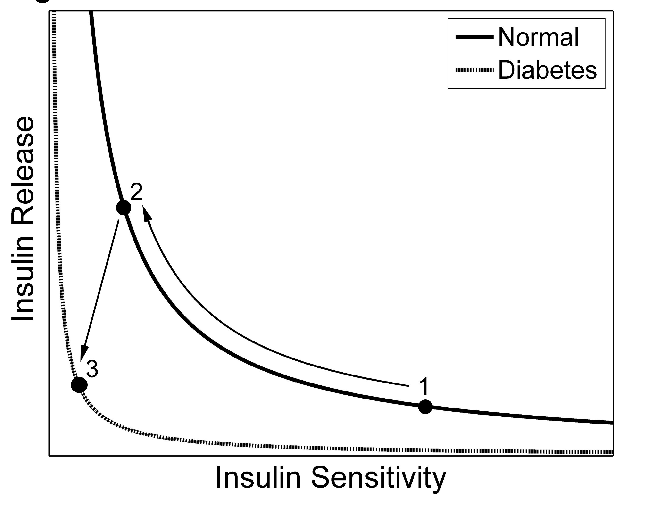
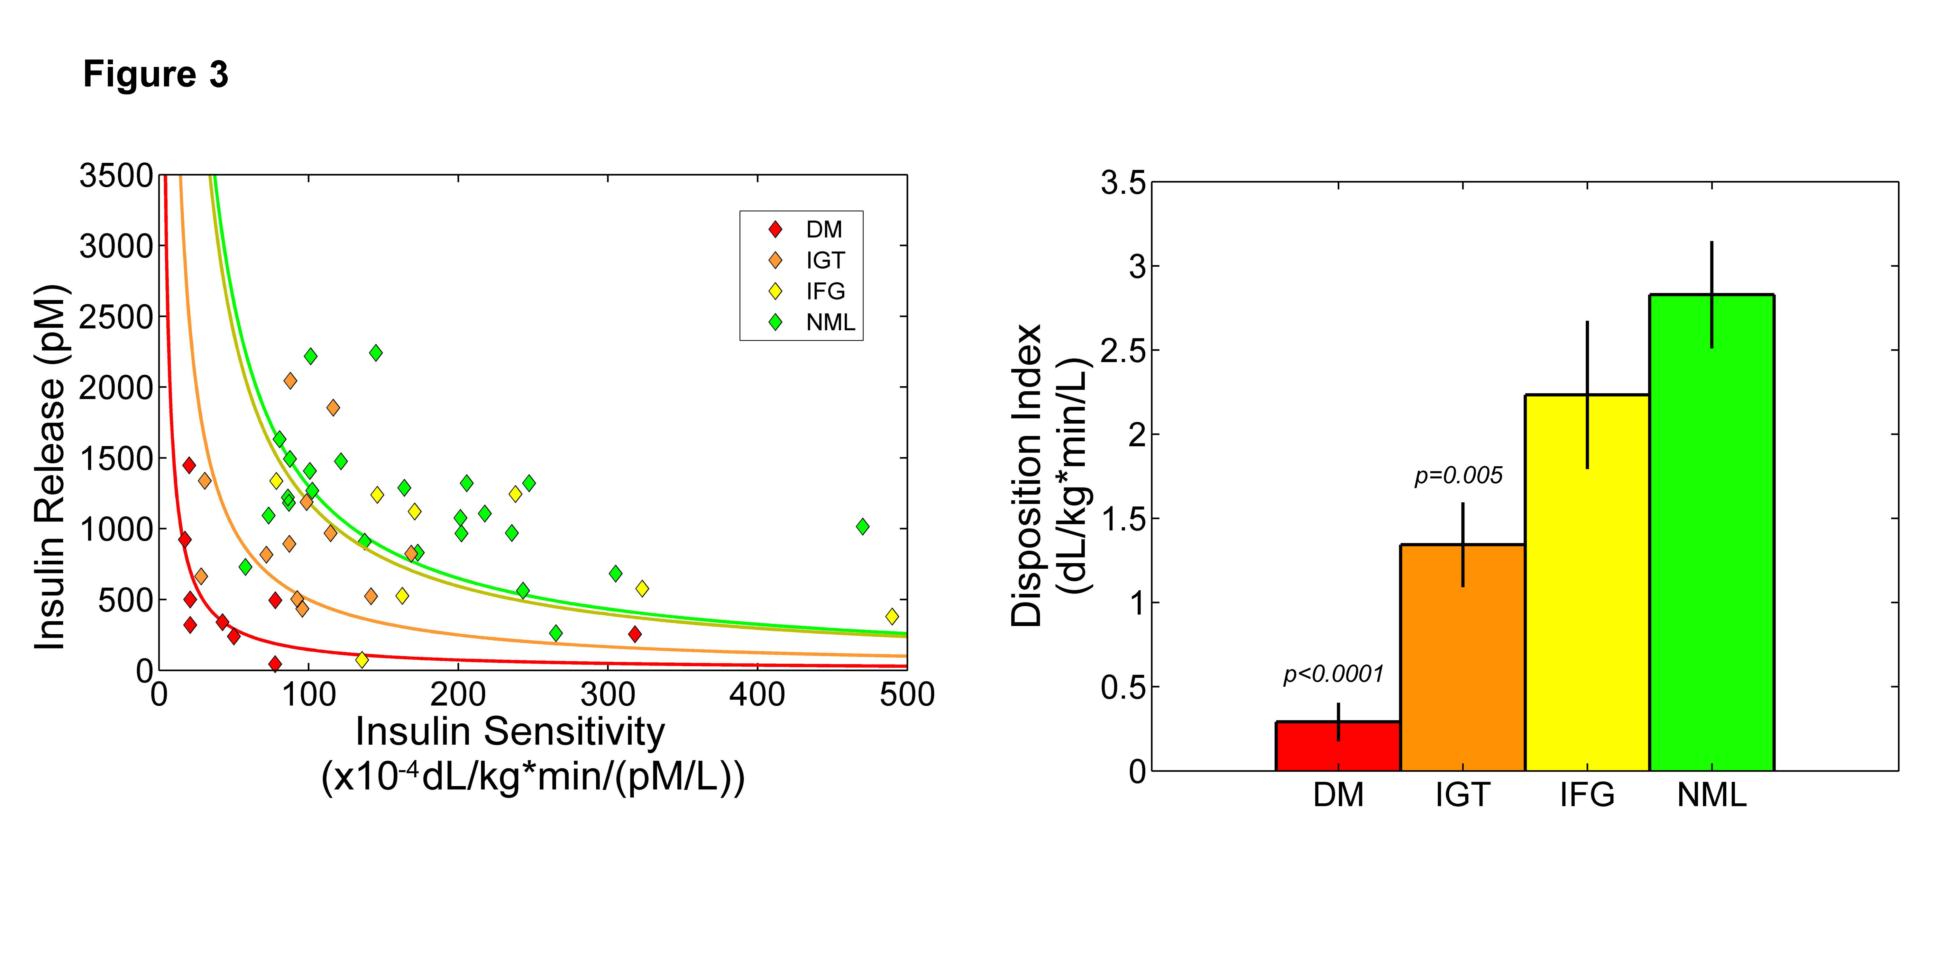
Pancreas R2* and glucose dysregulation
Disposition Index
DM: Diabetes Mellitus
IGT: Impaired Glucose Tolerance
IFG: Impaired Fasting Glucose
NML: Normal Glucose Tolerance
Noetzli et al, Am J Hematol, 87(2):155-60, 2012

Slide 19
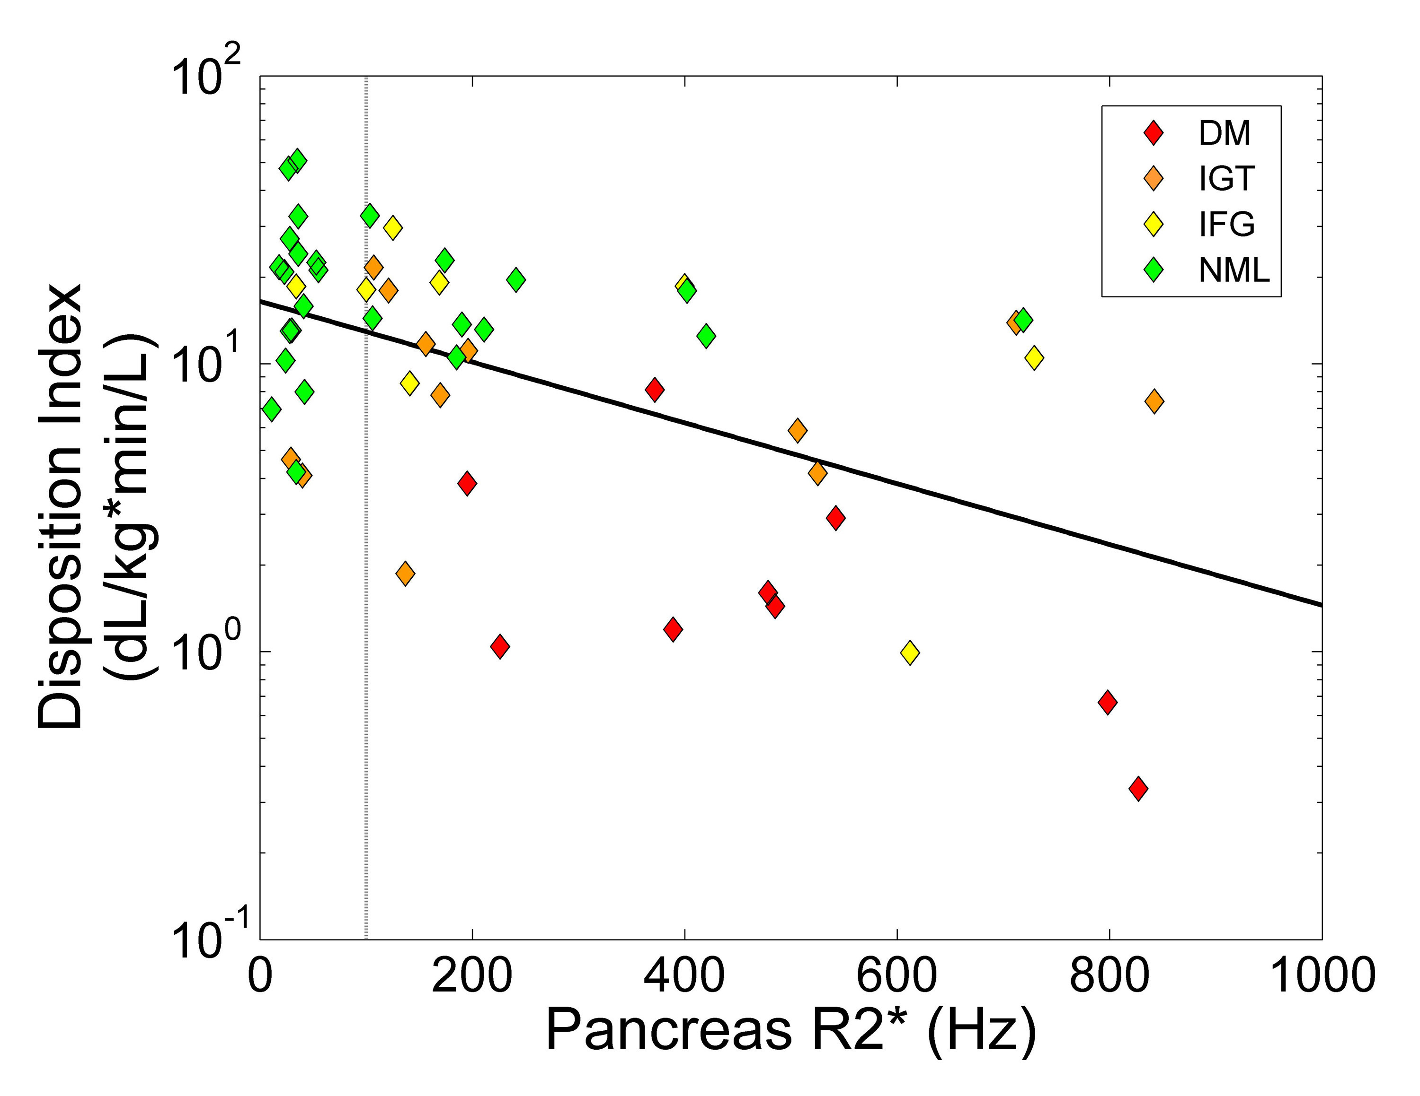
DI Correlates and Predictors
Age & LIC
DI values stratified by disease severity
DI predicted by pancreas R2*, age, and LIC
DI declines with age in everybody
Noetzli et al, Am J Hematol, 87(2):155-60, 2012

Slide 20
Prevalence of Endocrine Dysfunction
Endocrinopathy | Borgna-Pignatti 2004 | Vogiatzi et al 2009
Hypogonadotropic Hypogonadism | 54.7 | 51.3
Hypothyroidism | 10.8 | 12
Diabetes Mellitus | 6.4 | 14.1
Hypoparathyroidism | -- | 2.1

Slide 21
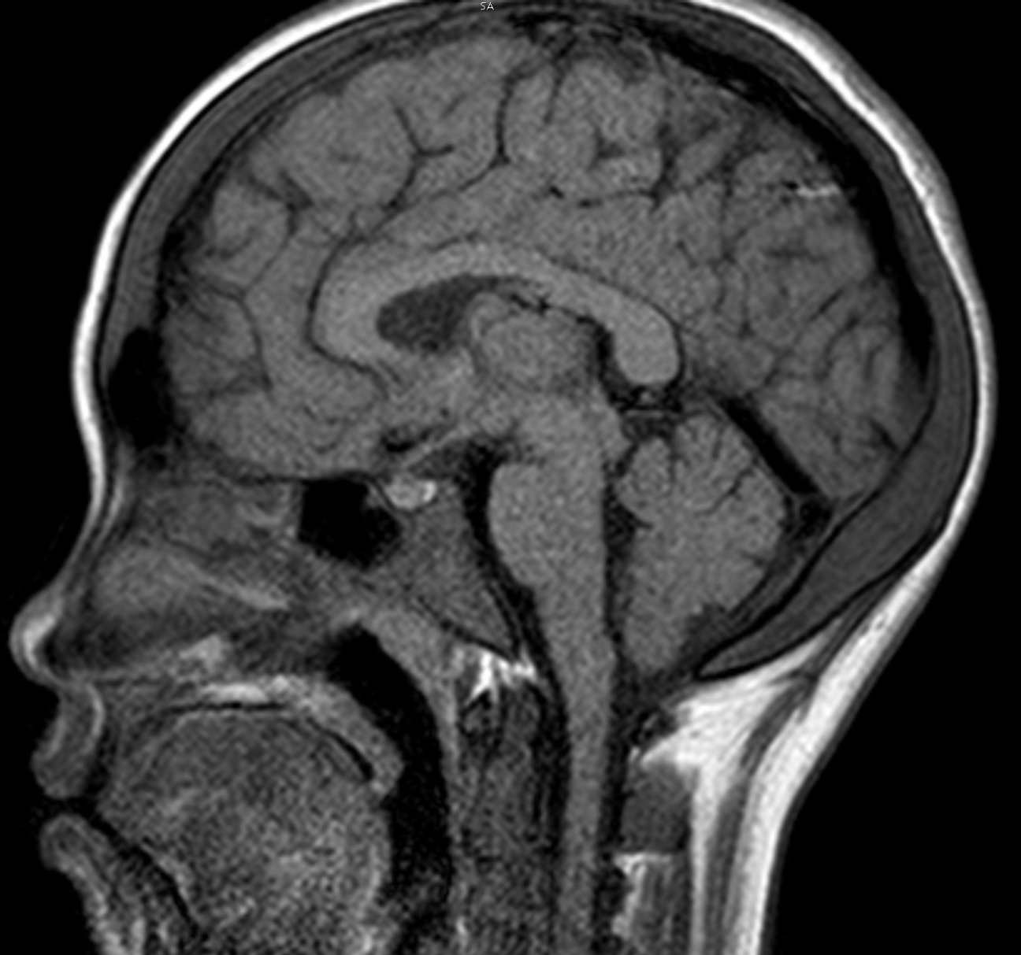
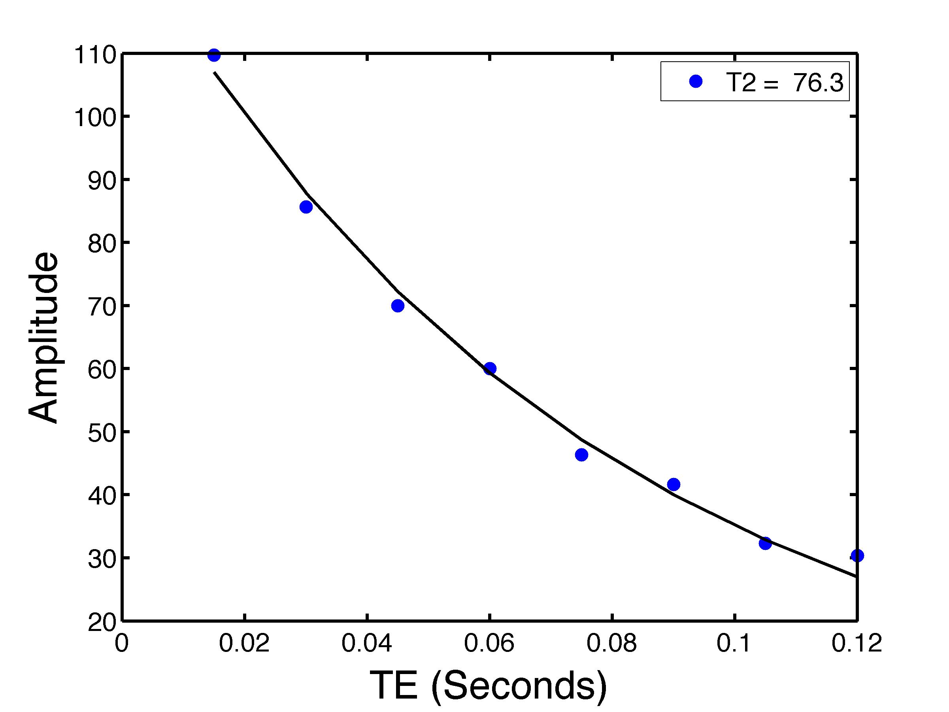
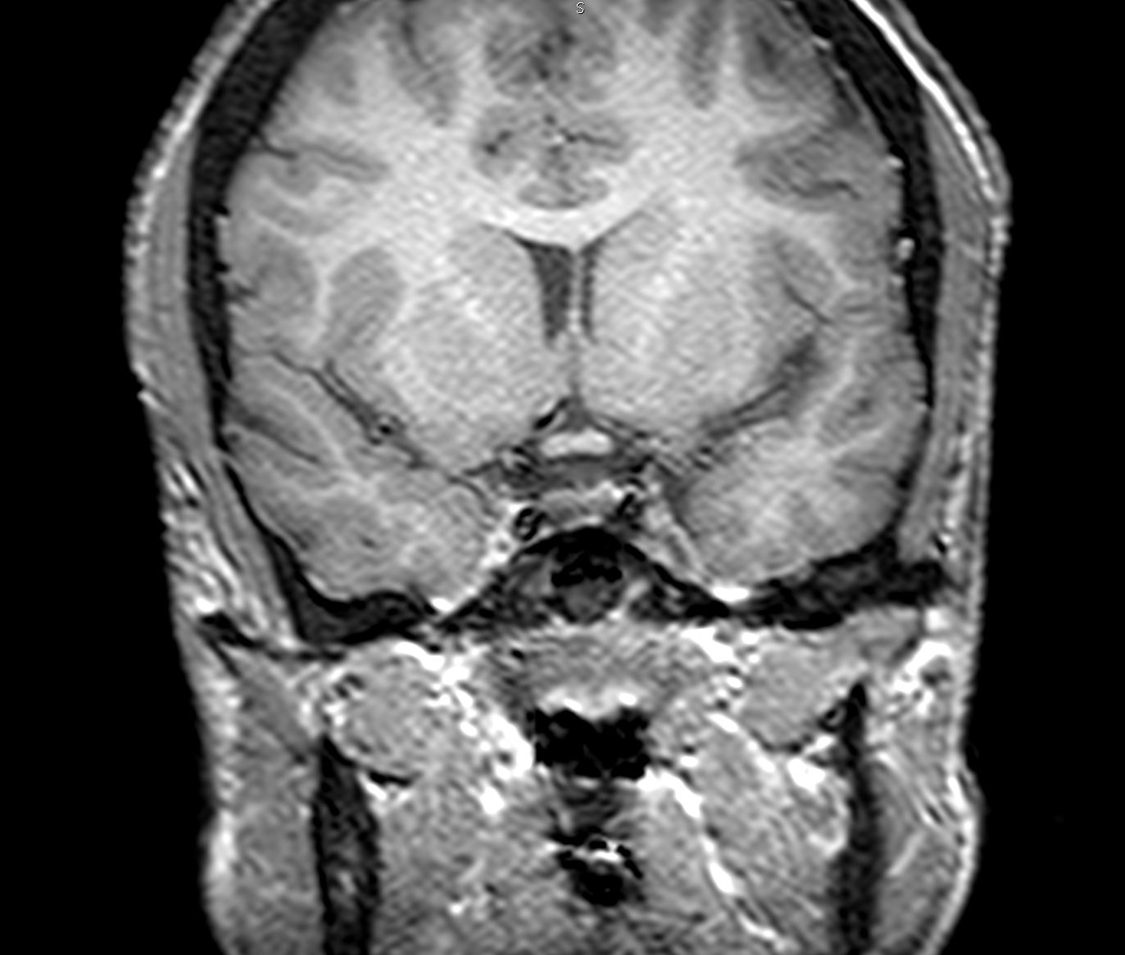
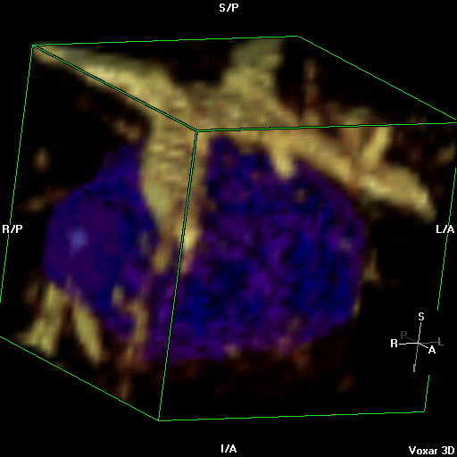
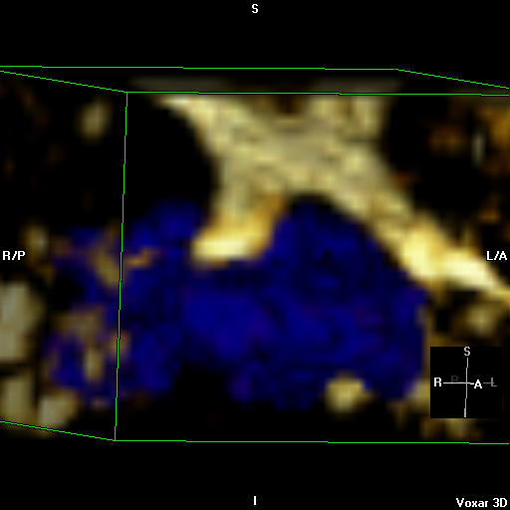
Imaging Pituitary Iron

Slide 22
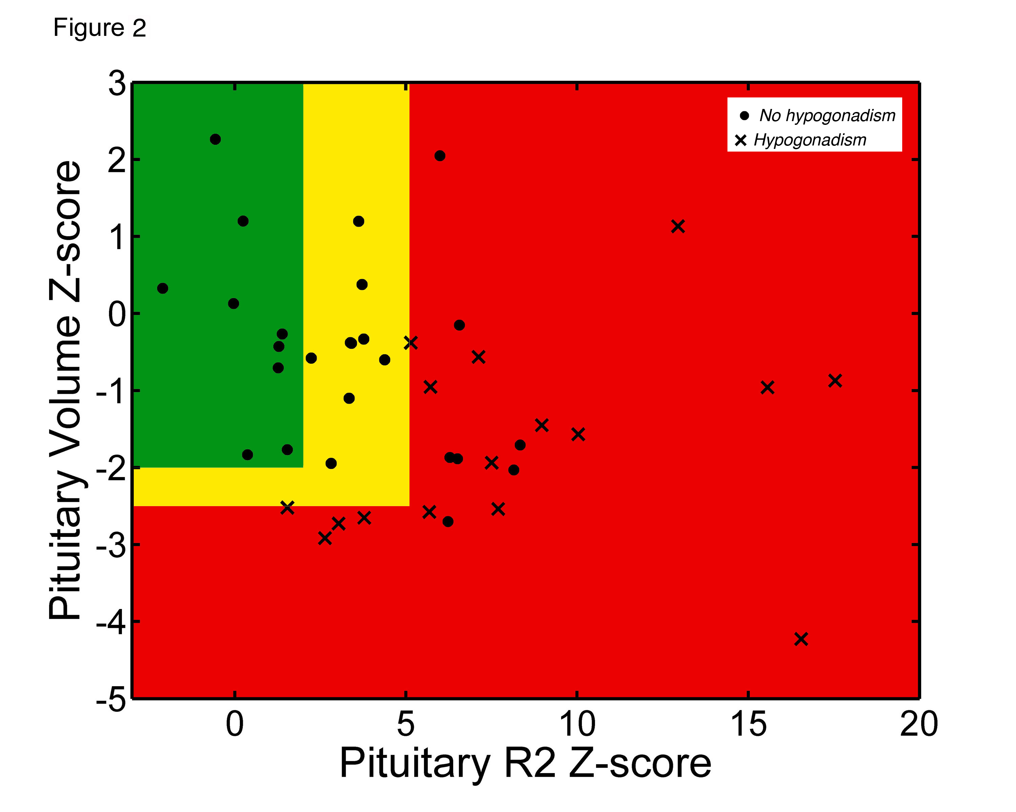
Clinical Correlation: Pituitary R2 and hypogonadism
Heavy Iron Loading
shrinkage
Noetzli et al, Am J Hematol 87(2):167-171, 2012

Slide 23
Summary
LIC by MRI is an excellent way to “anchor” trends in serum ferritin and titrate chelation dose
Routine cardiac T2* assessment is essential and has markedly decreased cardiac complications
Pancreas R2* reflects chronic NTBI exposure and is an essentially “free” measurement during liver R2* MRI
Pituitary R2 and volume convey risk of hypogonadism and may suggest which patients have reversible disease

Slide 24
T2* made easy: what radiologists need to know
Apr 14, 2018
10:00 AM - 12:30 PM
Capital Suite 10
Overview of iron physiology
Methodological details of T2* acquisition and analysis
Spread sheets for conversion for 3T -> 1.5 T data, iron calculations, pituitary Z-scores
Sample data for validation of local software

Slide 25

Questions?

